Slide 1
It Followed Me Home:
Status of Experiments/New Developments
Jason Carpenter

Slide 2
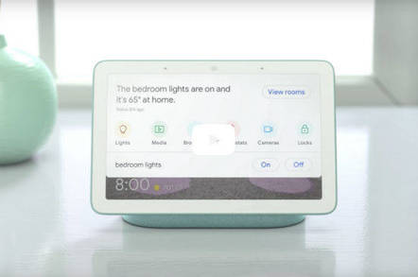
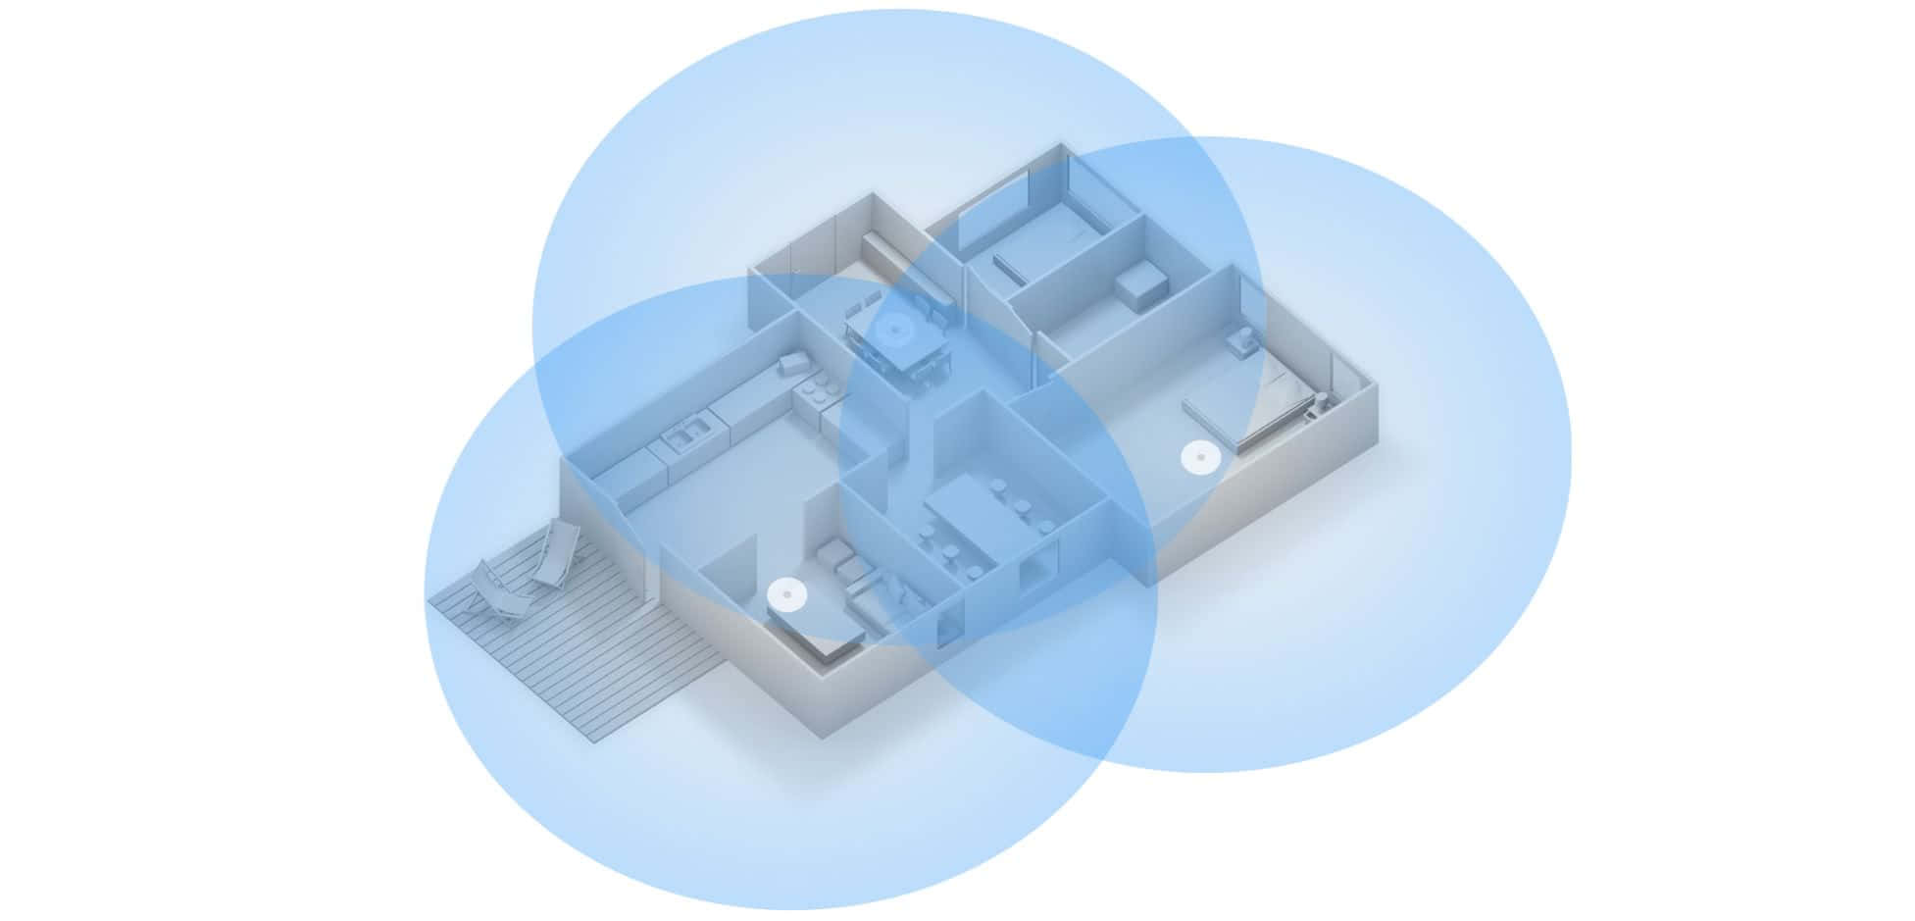
Recent Readings/Developments
Google
Google Wi-Fi
Coverage extension, likely “continuous” internet
Google Hub Home
IOT organization hub + small computing hub
https://regmedia.co.uk/2018/10/09/hub.jpg?x=442&y=293&crop=1
https://images-na.ssl-images-amazon.com/images/G/01/aplusautomation/vendorimages/38da719c-0b29-476f-af8a-f50606a1019d.png._CB528331191__SR970,300_.png
https://www.netspotapp.com/images/upload/screens/google-wifi-coverage.jpg

Slide 3
Recent Readings/Developments
ACM/IEEE SEC 2018
Security of IOT devices/Hubs
"HomePad: A Privacy-aware Smart Hub for Home Environments"
Reduction of raw sensor data “bleeding” out
"Vigilia: Securing Smart Home Edge Computing"
Network access restriction
Reduces target surface
Edge Performance/Coverage Expansion
"Scalability and Performance Evaluation of Edge Cloud Systems for Latency Constrained Applications"
Reinforcement of core principles (distance, latency, edge computing angles)
“From Cell Towers to Smart Street Lamps: Placing Cloudlets on Existing Urban Infrastructures”
Expansion of cloud edges via placement in city infrastructure

Slide 4
Recent Readings/Developments
ArXiv
“Towards Network-Failure-Tolerant Content Delivery for Web Content”
HTTP based delivery unreliable
Explores methods of improving this delivery
Redundant connections

Slide 5
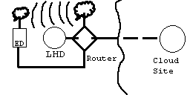
Base Experiment: Cost benefit of last hop for cache
Goal: Simply get anecdotal measure of gap between last hop vs cloud performance on a simple request
Using an end device (Laptop), strong last hop device (a desktop stand-in), wi-fi router, and publicly available cloud site (google.com in this case)
The Google homepage. Raw HTML text, 4.32 KB
The Google Logo off their website. PNG file, 5.82 KB, 272 x 92 pixels

Slide 6
Base Experiment: Cost benefit of last hop for cache
Confirmed straightforward assumption: distance increases latency
Test Host | Hops | TTC Image File (s) | TTC Text (s)
Cloud | 23 | 0.08268 | 0.17628
Local | 1 | 0.01092 | 0.01560
Test Host | Hops | TTC Image File (s) | TTC Text (s)
Cloud | 23 | 0.07176 | 0.20124
Local | 1 | 0.00936 | 0.00936
Wireless (Averages of ten attempts)
Wired (Averages of ten attempts)

Slide 7
Base Experiment Issues/Extensions
Clean up
DNS redirect inclusion (important as many CDN’s utilize redirect to manage loads and move requests closer)
Cleaner testing
Hardware standardization
Formula for cost/benefit of placement of a last hop device relative to users’ path quality
Eg: does it add value to place a LHD at this end? (But done for individual users)
Formula can be paired with many applications (optimizations, policy, planning, etc)

Slide 8
Multiplexing Experiment: Status
Still in planning stages, need more knowledge, equipment, etc
Planned first stage is “two split” bluetooth and wi-fi, and using purely abstract data
Once built, and rough tested, can then invest in a mobile emitter, or a modulated wi-fi router
Built off of idea present in HTTP2.0 (“Get it there fast, and without extra prompt”)
This is an extension of the base experiment, except with a split of content at last hop level, chunk into separable data and deliver over disparate means
Comparison will encompass standard call, synchronization time, data speeds, separation overhead

Slide 9
Multiplexing Experiment Approach
Using the apparatus setup for the base experiment
Simply attach one more transmission device (bluetooth or mobile emitter)
Send two discrete data chunks over line following the data definition criteria
Measure time to completion and difference in completion rates
Data Diagram:
Prioritization Model
[High Priority|Med Priority|Low Priority]
[High Speed|Med Speed|Low Speed]
[Reliable Connection|Med Connection|Unreliable connection]
[Short Distance|Med Distance|Long Distance]
Chunk Model
Video Example [Image|Audio|Metadata “eg: Closed Captions”]

Slide 10
Multiplexing Experiment Issues/Extensions
Data may not be chunkable
Delivery desync may be too much for real time, and complexity cost of “reassembly” may overwhelm multiplex advantage
Cost of additional emitters may overwhelm the device affordability
Only an issue for the LHD, may be mitigated by variant device integration
Physical Spectrum noise may reduce practicality of using all three modes

Slide 11
Prepopulation Experiment: Status
Goal: Precache/preload content before user knows they want it, or schedule downloads ahead of time, thus providing a higher quality and more immediate delivery response
Using downtime can increase link utilization for end users
Still in the planning and development stages, raw code is working, but results of running are not experimentally consistent, valid, or an accurate model of aim

Slide 12
Prepopulation Experiment Approach
User: Generates a request for Media Items
3 User types, biased, random, focused
Cacheless client assumption
Media Item: Titled container with metadata
Uptime:
User will request a media item
Server serves, notes metadata aggregate of requests
Downtime:
Make a guess for preload
Post-Guess Uptime:
Same as standard uptime, ideally will have a likely next request

Slide 13
Prepopulation Experiment Musing
Issues:
Lack of hardware standardization
No cross traffic consideration
Simple metrics, simple users
Eg: prediction is simple average of traits of last n requested media items
Media use simplified metadata, users likewise
Cloud server not present yet
Advanced angles/Extensions:
Expanding to utilize various prediction approaches and timings for prediction space
Multiple media predictions (eg: cross media types)
Guessing when downtime will occur and using the window length to download
Simpler approach of preloading percent of media from user “queue” or system created recommendations list
Useful if user follows queue and utilizes queue
If not for LHD, can look at aggregate user queues and form “union” of common queue entries to preload

Slide 14
Design of Last Hop device: Status
Goal: Create a LHD that is flexible, scalable, platform for shared or individual computational resources
Want to improve PC, by just adding modules to it, plug and play ideal, also want flexibility to “rent” space at the node itself without VM management or risk of cross over
Consideration: Should look like a mini server rack, but we want more flexibility in hardware scaling and software heterogeneity
Taking some notes: Ming-Hong Yang’s : Research on High Performance Computing with Shared Persistent Storage
Namely the idea of adding memory, cpus, storage, dynamically

Slide 15
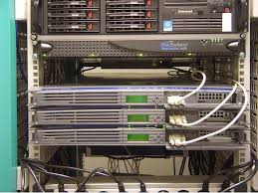
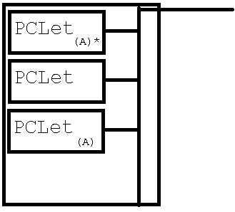
Design LHD Approach
PClets connected on shared network bus, each PClet will function as shared resources or individual as small PCs
PClet groups will be governed by a leader PClet
Resembles more or less a standard data center setup, or networked computer setup
“Cheaper/simpler server rack”
Hopeful contribution is a more streamlined plug and play “scalable” server rack, just plug in PCLets to add/scale functionality
Scaling is still bound by bottlenecks and known CAP issues
Src: Ars Technica

Slide 16
Design LHD Issues/Extensions
Bound by bottlenecks
Governor, network, display output, job assignment, etc
Code replication issue
Send code with data, or replicate applications across modules
“Phonebook” approach (paired with next experiment)
Give local users a way to find other locals, especially relevant for local businesses and for authenticity/searching that is decoupled from “Google” or search engines that are private/central private

Slide 17
Anonymity Experiment: Status
Problem: anonymity on the internet
Goal: Provide verification of sender
Done through certificates, data fingerprinting already
Difficult to enforce due to lack of “push” and emphasis on performance over security
Approach:
Like Mailboxes, provide fixed point that can be tied to a geographic location, and a “harbor” of information
Have and LHD publicly display information for communication and validation of user

Slide 18
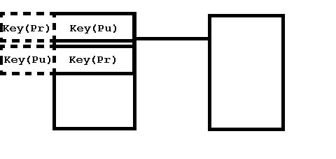
Anonymity Experiment Approach
Multi key system: User public key (potentially rotated on schedule) private key pair
4 keys: Public/Private Keys (Communication), and second Public/Private Keys (Signature)
Eg: User A has a public data page, showing two public keys (One is for A’s signature, other is for sending data to User A)
Create a message, encrypt a section of the message with the public signature key, this is the signature
Encrypt overall message with public key of targeted user
User receives, decrypts with their own private key, and then uses the second public facing key of the sending user to decrypt the signature block, if it decrypts properly, then we verify the user’s signature
Note: This approach is already done, but LHDs may provide a logical place to store/read these

Slide 19
Anonymity Experiment Issues/Extensions
Need to delve deeper into the impact of traffic fingerprinting (cost)
Potential issues:
Redirected messages, potentially fixable with inbuilt hash
Fingerprint forgeability
Validity of the 4 key approach
Issue of preventing man in the middle attacks on first acquiring the proper signature and location of send information
Eg: first step navigation (I have no address and must find the address of the place with the signature/validation of id)

Slide 20
Anonymity Experiment Extensions
“Phonebook” approach
Give local users a way to find other locals, especially relevant for local businesses and for authenticity/searching that is decoupled from “Google” or search engines that are private/central private
Achievable with basic static webpage hosted on LHD, if experiment yields fruit would provide reasonable verifiability
Software solvable
Key Based Isolation of IOT devices
Every device gets Public Key Pair, and device to exterior

Slide 21
Questions?

